Slide 1
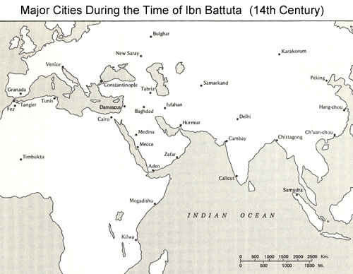
Use link from Mr. Steen’s website to track Ibn Battuta’s travels: Mark major points on this map (including the points discussed in the reading). What does this tell us about African civilizations?

